Slide 1
Hazards – UK perspective
1st Tech Workshop on Standards for Hazard Monitoring, Databases etc.
Graeme Forrester, WMO Geneva, June 2013

Slide 2
Contents
This presentation covers the following areas
Hazards for the UK
Context, Risk Assessment etc.
Natural Hazards Partnership
Multi-agency expertise, Impact Modelling
Collecting Impact Information
Sources and challenges
Questions?
Notes:
Look at the issue from the UK perspective – outline some of the work going on in this area at the moment
Three sections
Put into context how we operate in the UK – brief loom at the national risk assessment process
Look at the NHP – a multi-agency collaboration looking to address issues arising from natural hazards, look at some of the aspects of work it is carrying out – bit daunting given the current head of NHP is here today representing CBS but it does mean he can answer the difficult questions!
Finally I’ll look at the work going on in relation to gathering information on impacts from natural hazards.
Look particularly at where we get such information and some of the challenges associated with collecting such data

Slide 3
Risk Assessment in UK
Hazards Identified
Events which threaten serious damage to human welfare and/or the environment in the UK
“Reasonable Worst Case” chosen
Lead agency identified for each hazard
Information gathered on
Historical precedence, events
Expected impacts
Included in National Risk Register
Notes:
So let’s put a bit of UK context on to this
The UK Government carries out an annual Risk Assessment process looking at all types of hazards and threats which might affect the UK – “events which threaten serious damage to human welfare and/or the environment in the UK”.
This covers all kinds of events – severe weather, flooding, space weather, major accidents, flu pandemics, terrorist threats – everything. I’ll obviously just focus on the natural hazards but the methodology for carrying out the assessment is the same for all.
The hazard gets identified and a reasonable worst case is set out - the rwc is a “challenging manifestation of the the scenario after highly implausible scenarios have been excluded.
A lead agency is identified to “own” that hazard 0 usually a government department or agency with expertise in the area – so, for example, the Met Office “owns” the severe weather risks
Information is gathered on any events similar to the rwc looking at historical precedent etc and an assessment is made of the likelihood of such a scenario occurring.
Government departments and agencies then assess the impacts such an event might be expected to have on their sector.
The likelihood and an overall impact level are then defined and the risk is placed on a risk matrix which is then used to priortise planning across the resilience community in the UK.
The risk is put in to the National Risk Assessment and a National Risk Register is published and available on the government website.

Slide 4
UK Risk Register (Natural Hazards)
5
4 |  |  | Coastal Flooding Effusive Volcanic Eruption
3 |  |  | Inland Flooding | Severe Space Weather Low temperatures & Heavy Snow Heatwave
2 |  |  | Drought | Explosive Volcanic Eruption Storms and Gales
1
 | Between 0.005% and 0.05% | Between 0.05% and 0.5% | Between 0.5% and 5% | Between 5% and 50% | Greater than 50%
Impact
Likelihood
Notes:
Here is where the natural hazards – which are included in the NRA – sit on the matrix.
We see that coastal flooding and an effusive volcanic eruption are the risks which are expected to have the highest impact but Snow and Ice, Heatwave and Severe Space Weather are thought to be more likely. (given last few summers, the heatwave one seems less likely!)
Not that the likelihood scale is logarithmic.

Slide 5
Other Hazards for the UK
Weather (Rain, Wind, Snow, Ice, Fog)
Flooding
Extreme temperatures
Lightning
Hail
Air Quality
Aero Allergens
Space Weather
Volcanic Ash
Landslide
Notes:
This slide just shows a list of hazards we consider to be likely to affect the UK
Note that “Weather” includes those elements explicitly addressed by the NSWWS – which I’ll say a bit more about shortly.

Slide 6
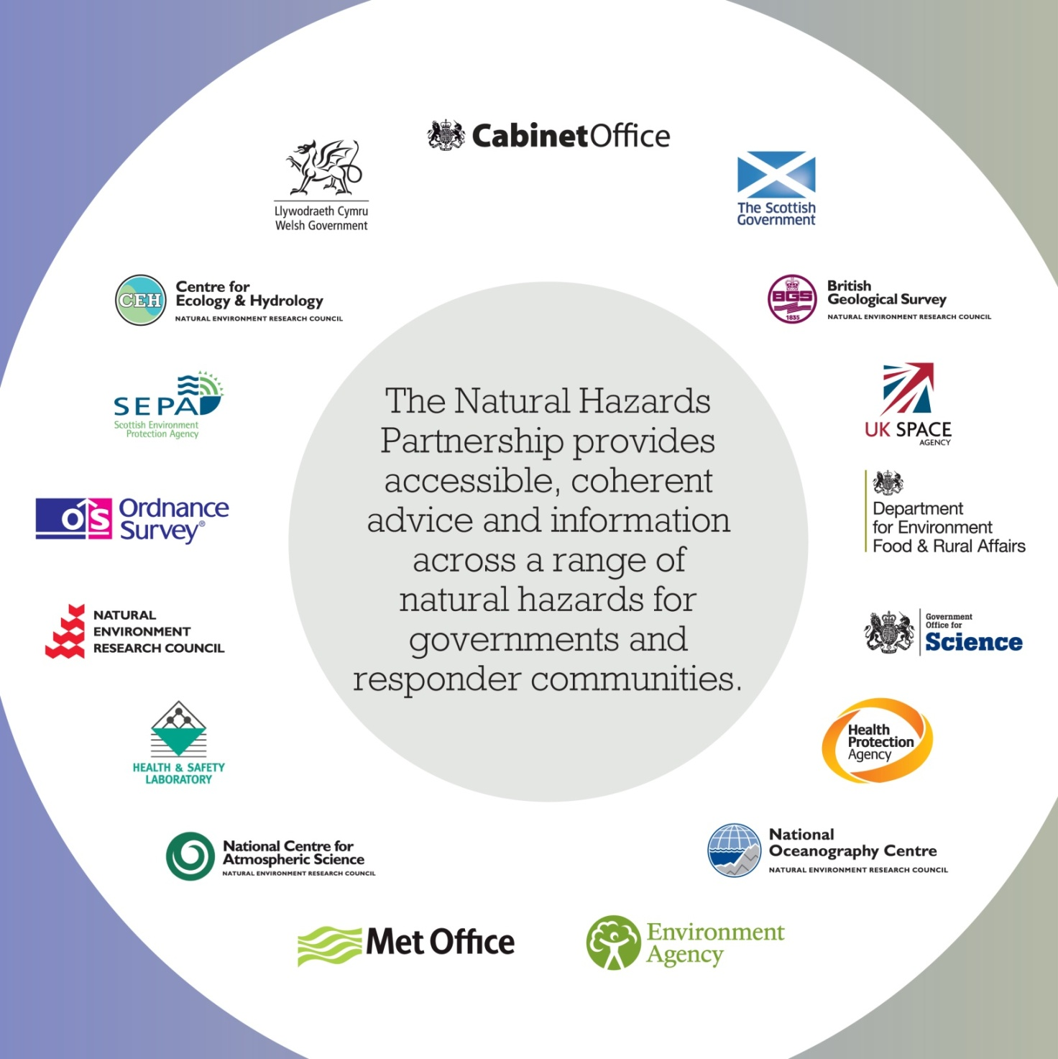
Natural Hazards Partnership
Notes:
So that’s the context. What are we doing in relation to Natural Hazards.
Formed the NHP – a group of government departments and agencies brought together to provide coherent advice to government and responder organisations. Been going for about 5 years now.
Quick tour round the organisations (some of)
Cabinet Office – main government department for Civil Contingencies – produce the NRA (Civil Contingencies Secretariat)
Devolved administrations – SG, WAG
Flooding and pollution lead agencies, EA, SEPA
Public Health England (ex-HPA)
BGS
Several research agencies, HSL, Ordnance Survey (mapping)
Resilience
Natural Hazards
Fast tracking world class science into services
Timescales 0 to 5 years
UK and in those countries affecting UK citizens
Governments and responder community
Public good
Non commercial

Slide 7
NHP Aims
to provide a timely, common and consistent source of advice to government and emergency responders for civil contingencies and disaster response.
to deliver a forum for the exchange of knowledge, ideas, expertise, intelligence and best practice in matters relating to natural hazards and
to provide an environment for the development of new supporting services.
Notes:
The NHP aims to:
Give timely, coherent and consistent advice to government – before, during and after incidents
Work together to exchange knowledge, best practice etc.
Work toegther to develops ideas/products which might help the responder community

Slide 8
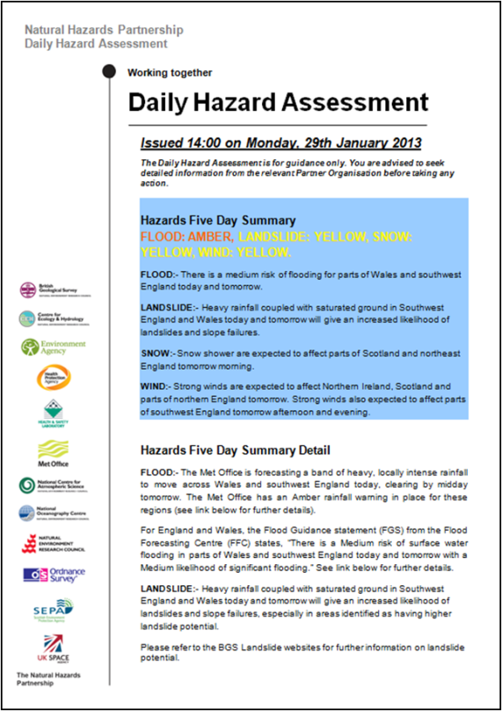
NHP Achievements so far
Improved cross-working = more joined up scientific advice and analysis.
Provision of single source of daily hazard assessment.
New level of scientific expert challenge to the UK NRA.
The provision of pre-prepared scientific advice packs for all emergency responders.
Notes:
So what has the NHP done so far?
It has certainly improved cross-agency working and produced more joined up advice etc.
In terms of products – daily hazard assessment – looking at the various hazards identified for the UK and giving a daily assessment of them – this is currently only going to partner agencies and government agencies but as the product develops, it is hoped soon to be able to issue it more widely across the emergency response community in the UK.
Bringing together a more coherent scientific expert challenge to the UK NRA process.
Pre-prepared scientific advice packs – these summarise the issues likely to arise from specific hazards helping to focus the planning for any incidents and, amongst other things giving a nice concise summary to feed to politicians should the need arise!

Slide 9
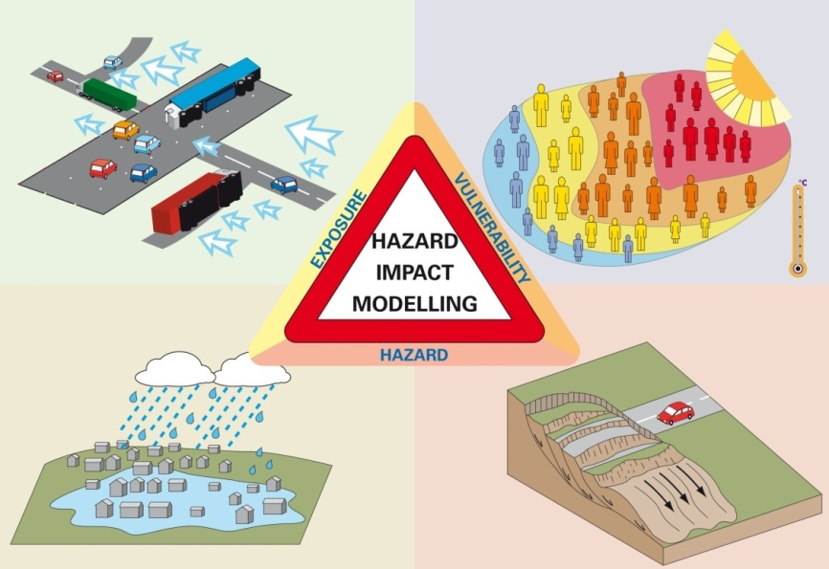
Working in partnership
Develop a Multi-Hazard Impact Model
We want to find out where the risk is likely to be greatest (which areas/assets are most vulnerable)
Why? To help people to prioritise where to deploy ‘responder’ services and aid the decision making process in issuing hazard warnings.
Notes:
Another area NHP is looking at is developing a multi-hazard impact model

Slide 10
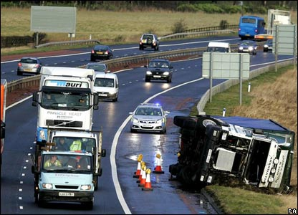
Impacts of winds on transport network
Strong winds can result in vehicles overturning.
Can we identify areas of highest risk?
Notes:
One example of this might be looking at one impact of wind on the transport network

Slide 11
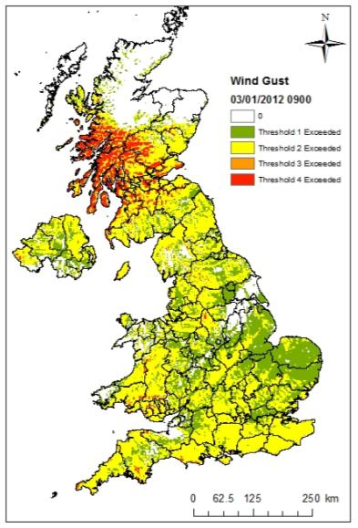
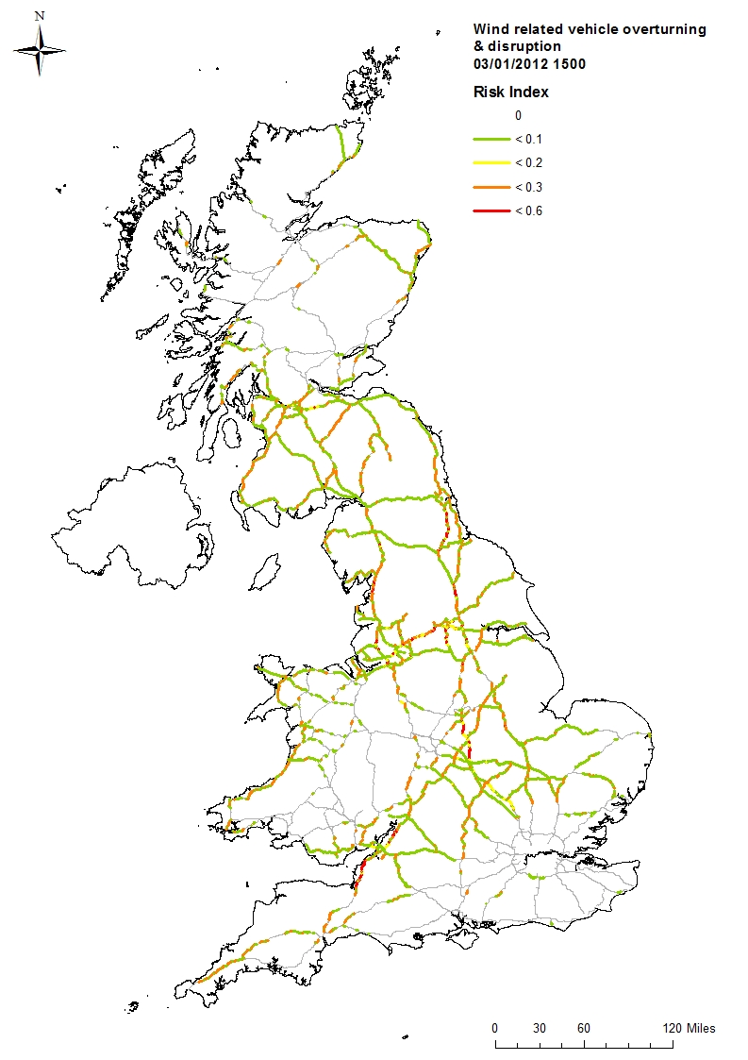
Impacts of winds on transport network
Impact
Hazard Footprint – defined by wind gust thresholds
Risk index – green lowest risk, red highest risk
Notes:
If we can identify the level of wind gust which increases the likelihood of high-sided vehicles overturning we can use these levels, with direction, then look at the road network to identify sections of road which have a higher risk of overturning
Highway authorities can then perhaps focus their resources on these areas to help keep the network running or to improve the speed of recovery if incidents do occur.

Slide 12
Collecting Impact Information
Why do we want to gather impact information?
To learn more about the effects of natural hazards on people, infrastructure and organisations
To inform the risk assessment process
To help develop focussed warnings and to validate them
To help develop impact modelling capability and to validate such models
Notes:
That’s a very brief summary of the work of the NHP.
Back to the reason for this workshop though and the collection of impact information. Why do we need to get impact info?
For me, one of the primary reasons is to better understand my “customers”. As a National Met Service, we issue weather warnings to the public and to emergency responders and the more I understand about their issues and how the weather impacts on their operations, the better I can help them assess the risks they have and the better I might be able to focus warnings to their requirements.
As we look to develop impact models, we need some way of validating them and also to feed back in to them to develop their capability.
If I may I’ll just digress slightly and say a bit about our National Severe Weather Warning Service which, since March 2011 has been impact based i.e. we issue warnings not on meteorological thresholds but on the poten

Slide 13
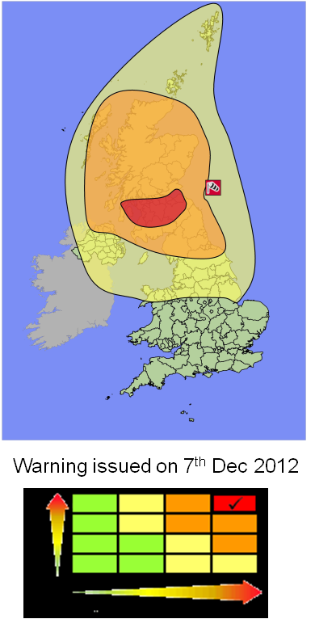
Weather Warnings
How are warnings issued
Assess the weather situation
Assess the impact the weather might have
Assess the likelihood of the weather having some impacts
Having assessed the possible impacts and the likelihood, the warning is assigned a “colour” – Yellow, Amber or Red – according to a matrix
Weather warnings issued for wind, snow, rain, ice and fog
Notes:
How do we decide to issue a warning?
The first thing our forecasters do is assess all the output from the various computer models and use their experience and judgement to assess what is going to happen
If the weather is going to be bad then we assess what kind of impacts the it might have (I’ll come back to that in a moment)
Then we assess the likelihood of the weather having those impacts e.g. how confident are we, what are the uncertainties etc.
Then having assessed the likelihood and the possible impacts we plot these on a matrix and assign a colour
The example of the warning higlighted here is from a severe wind storm we had across central Scotland on 8th Dec 2011.
Winds of 80-90 mph were expected across the most populated parts of Scotland it it was assessed as being highly likely to result in high impacts - RED

Slide 14
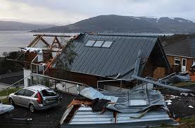
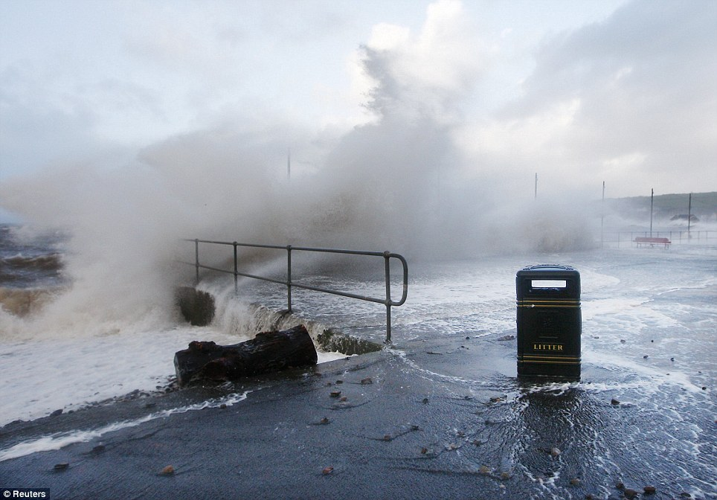
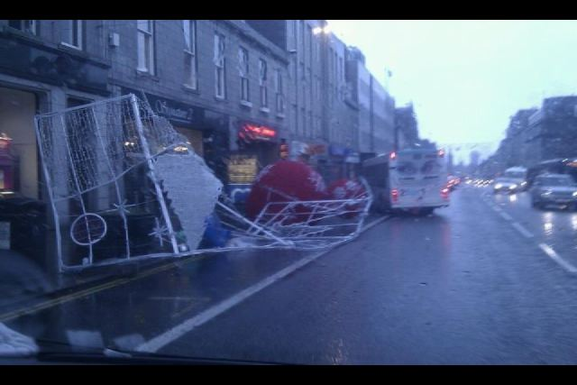
Weather Warnings
Notes:
Sure enough!

Slide 15
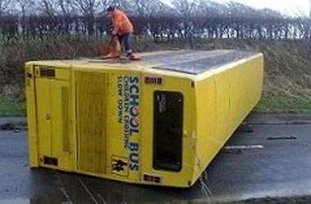
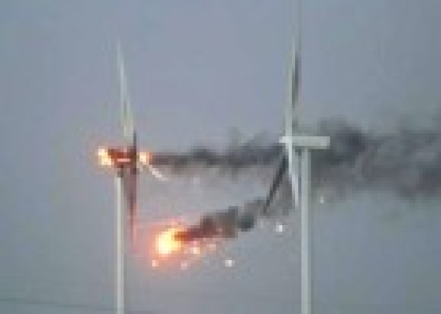
Weather Warnings
Prior to RED warning being issued
Consultation with government and transport authorities in Scotland to consider impacts
Police issued travel advice to the public
Scottish Government issued advice to close schools
Dialogue between authorities and Met Office advisors before and during the event
Notes:
Prior to the RED warning being issued we had conversations with the Transport authority in Scotland and Scottish Government and in view of the timing of the storm – hitting the west in the morning rush hour and the east later in the day, the impact was assessed has being potentially high.
Police issued advice to the public to avoid travelling, and SG issued advice to schools to either stay closed in the morning or close at lunchtime. (Note photo of overturned school bus – which was empty!)
Despite the intensity of the storm there were no fatalities.
A point also to note is that if this intensity of storm had occurred up over the Highlands of Scotland, we quite probably would not have issued the highest level of warning as the impacts (much less population, less property to damage etc.). This we see as one of the advantages of impact based warnings – it focusses responders according to the impact on their communities (some communities more resilient to wind than others)

Slide 16
Collecting Impact Information in the UK
Agency databases e.g. Fire & Rescue Services
Media reports
“Crowd-sourcing” – WOW
Social Media
Notes:
Given that our weather warnings are impact based, we need somehow to validate them by looking at the impacts which result from the weather and this is another of the drivers for wanting to collect impact information
Work in the UK on this is in early stages and we are trying to collect assess and collate data from a variety of sources. Four general areas highlighted here.

Slide 17
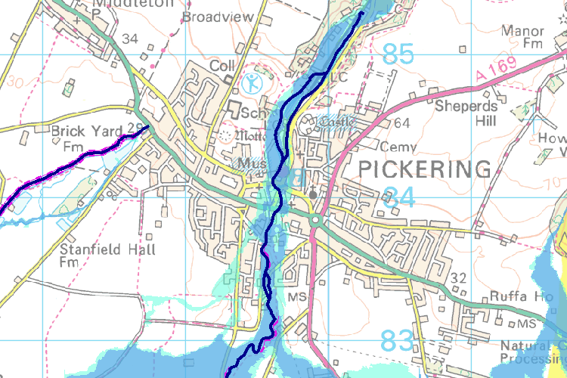
Agency reports
Various agencies collect information relating to events
Environment Agency, Scottish Environmental Protection Agency, Natural Resources Wales - flooding events
British Geological Survey - landslides
Other responder agencies (e.g. Fire & Rescue Services, Local Authorities) have general information in the impacts on their organisations
Notes:
Various agencies in the UK collect data on incidents of interest to them For example
EA , SEPA collect information on flooding events and have records going back many years.
BGS has data on landslide which have occurred over the years
Various other responder agencies have data specific to their organisations – so FRS will have data on fires and flooding in particular
Local authorities and others might have data on events but will they be identifiable as being linked with a natural hazard?

Slide 18
Agency reports
Advantages
Good quality information
Measured and rational
Can be wide ranging
Disadvantages
Many organisations can be involved in an incident making collation of data difficult
May not be fully available until well after the event
May be sensitive data issues
Notes:
We can be sure that such databases will be of reasonable quality of information – measured and rational assessments of the impact(s). The various databases might cover a wide range of impacts on things like transport, health services, fire services, local authorities etc.
Some of the disadvantages
Pulling all the various bits of data from these various locations can/will be difficult
Some of it may not be fully gathered until well after the event
There may be sensitive data issues – some of the databases may contain personal details of individuals which should not be shared outside the appropriate authority so we need to gather only what we need for our purposes.

Slide 19
Media Reports
Advantages
Timely – often the first indication of an impact comes via media reports
Disadvantages
Can be sensationalised
May not pick up very localised impacts
Can be strongly biased towards populated areas
A lot of media outlets, so difficult to monitor comprehensively
May be difficult to analyse, map etc.
Notes:
One of the great sources of impact info is of course the media. I’m sure the UK isn’t the only country where the first information you get from a incident comes from a news channel’s helicopter!
One advantage of these then is their immediate availability. However…
Sensationalist!

Slide 20
Crowd-sourcing
The growing world of social networking online makes it relatively easy for anyone to get involved and share their weather observations.
The Met Office is helping to co-ordinate the growth of the weather observing community in the UK, by asking anyone to submit the observations they are taking to its 'Weather Observations Website' (WOW).
WOW reflects recent advances in technology and how weather observations can be made.
Can be done using all levels of equipment, so there are no cost restrictions.
Notes:
One of the source of impact data we’re starting to look at in the UK is data from the public.
Can we use social networking ideas to improve our knowledge and coverage of impact data?
WOW – as slide
Weather sites not necessarily WMO standard but there are some very high quality amateur weather observers who we can make use of and the density of potential observations helps with quality assessment of the obs too.

Slide 21
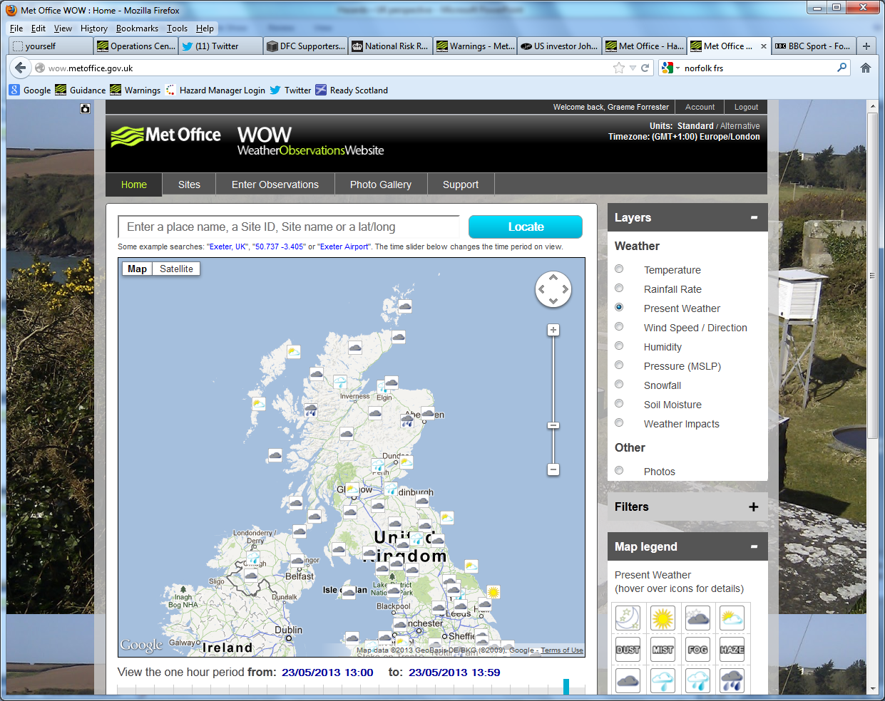
WOW
Notes:
This is how the WOW page looks when impacts are displayed
WOW allows members of the public to put in weather observations and these are retained on a database. (anybody can sign up through the Met Office’s website.
We’re expanding that idea to include impact information.
At the moment it can’t be done from mobile devices (iphones, iPads etc.) but work is going on as we speak to rectify that as we feel that once the application is available on mobile devices we are more likely to get real time data in greater quanities.

Slide 22
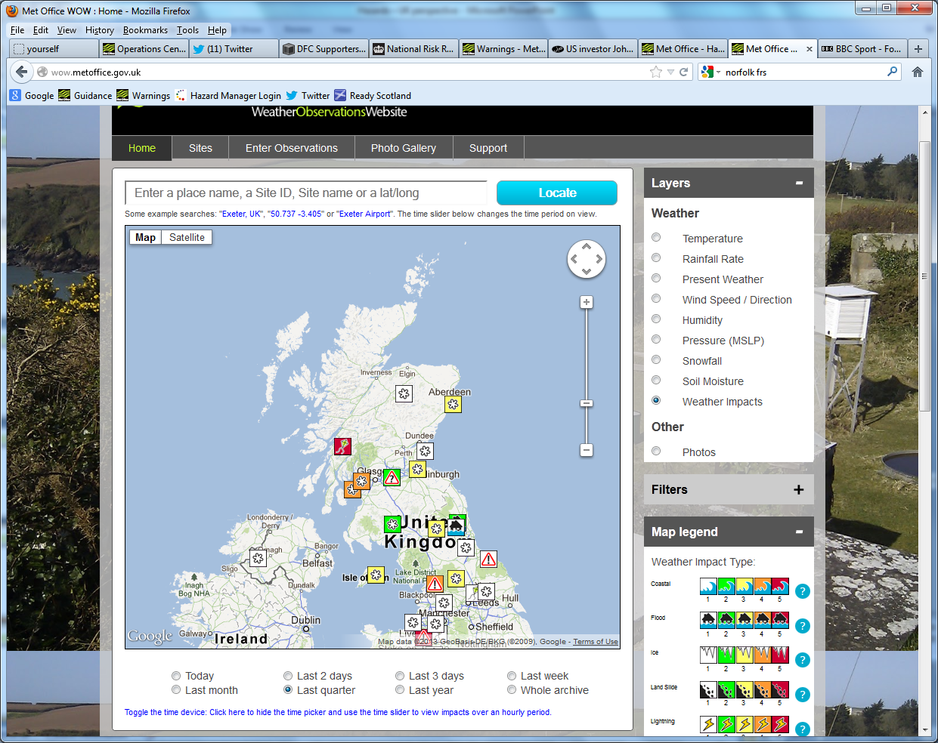
WOW
Notes:
This is how the WOW page looks when impacts are displayed.

Slide 23
Example of WOW Impact Scale
WIND
Level 1. | Damage to trees, but no disruption caused.
Level 2. | Damage to trees causing disruption to transport or property damage.
Level 3. | Damage to trees causing damage to power or telephone cables.
Level 4. | Transport disruption directly by wind.
Level 5. | Damage to property caused directly by wind alone.
Observers can input their assessment of impacts on a scale of 1 to 5
Notes:
Observers can put in an impacts on a scale of 1-5 and this is an example of the types of impact used to guide the observation – perhaps needs some work done on it?
Other impacts:
Coastal
Flood
Ice
Land Slide
Lightning
Poor Visibility
Snow
Wild Fire
Wind
Other Impact
Multiple impacts

Slide 24
Crowd sourcing - WOW
Advantages
Potentially a lot of information with local detail
All info in one place – easier to analyse, map etc.
Disadvantages
Quality of observation may be variable
May be strongly biased towards populated areas
Notes:
Huge amount of info possible – especially when it is accessible from a mobile device.
The database can be linked in with our meteorological databases
Can be readily mapped
Quality of ob can be variable but we can to some extent assess the observation quality of our weather observers (regular contributors usually give good, reliable observations) – we may be able to use this to give a first order assessment of the quality?
Obviously again, biased towards populated areas.
Work in the early stages – hope to ahave some kind of fuller assessment done by this time next year.

Slide 25
Social Media
Advantages
Potentially a HUGE amount of information with local detail
Disadvantages
Quality of observation WILL be variable
May be strongly biased towards populated areas
Difficult to collate?
Notes:
Another potentially vast source of impact data is through social media
As Met Office Civil Contingencies Advisors, we follow our local police, transport, LA twitter feeds and find it an invaluable source of info about issues developing around our regions. We’re probably only picking up a small fraction of the info available.
The Met Office is about to start a piece of work looking more closely at this and trying to work out how we can pick up impact information, indeed also how we might be able to encourage people to feed in data using our own Twitter and Facebook feeds.
The main challenge here though is collating all this info and perhaps mapping it as well

Slide 26
Summary of the Issues
Quantity
Potentially there are a large number of sources of impact data.
How do we manage that?
How to we gather it all together to do a proper analysis?
Quality
Varying levels of quality of report
How do we assess the quality?
Can we grade different sources and weight observations accordingly?
Notes:
So, just looking back on the impact data issues, I’ll just summarise what I see as some of the issues

Slide 27
Questions?

